Slide 1
Cloud Computing
Pre-Requisites

Slide 2
Cloud Computing
Reference Textbooks:
Rajkumar Buyya, James Broberg,Andrzej M Goscinski, Cloud Computing: Principles and Paradigms, Wiley publication
Toby Velte, Anthony Velte, Cloud Computing: A Practical Approach, McGraw-Hill Osborne Media
Mastering Cloud Computing by Rajkumar Buyya, C. Vecchiola & S. Thamarai Selvi McGRAW Hill Publication
Sosinsky B., “Cloud Computing Bible”, Wiley India

Slide 3
Course Outline
Pre-requisites
Introduction to Cloud Computing (CC)
Cloud Architecture, Services and Applications
Virtualization
Management and Monitoring
Cloud Security
Cloud Tools

Slide 4
What Is A Distributed Computing?
Distributed computing is a field of computer science that studies distributed systems.
Distributed computing also refers to the use of distributed systems to solve computational problems. In distributed computing, a problem is divided into many tasks, each of which is solved by one computer.
  -Wikipedia

Slide 5
What Is A Distributed System?
A distributed system is a collection of independent computers that appears to its users as a single coherent system.
- A. S. Tanenbaum et al.
A distributed system is defined as one in which hardware or software components located at networked computers communicate and coordinate their actions only by passing messages.
- G. Coulouris et al.
A distributed system is one on which I cannot get any work done because some machine I have never heard of crashed.
- Leslie Lamport et al.

Slide 6
Properties of Distributed Systems
Why do we use DS?
  Connecting Users and Resources
Desired properties:
  Transparency
  Openness
  Scalability
  Enhanced Availability
  Concurrency
  independent failures
  heterogeneity

Slide 7
Connecting users and resources
Computer resources include all hardware resources (e.g., disks, printers), software resources (e.g., compiler) and data resources (e.g., files) etc.
The main goal of a DS is to make it easy for users to access remote resources, and share them with other users in a controlled way.
Connecting users and resources also makes it easier to collaborate and exchange information.
Security becomes a big issue as connectivity and sharing increase.

Slide 8
Distribution Transparency
Why Transparency?
  To hide from the user and the application of the distribution of components, so that the system is perceived as a single system rather than a collection of independent components.
  Achieving distribution transparency makes everyone into thinking that the collection of machines is simply an old-fashioned time-sharing system, instead of a collection of independent components.

Slide 9
Transparency in a Distributed System
Transparency | Description
Access | Hide differences in data representation and how a resource is accessed
Location | Hide where a resource is located
Migration | Hide that a resource may move to another location
Relocation | Hide that a resource may be moved to another location while in use
Replication | Hide that a resource is replicated
Concurrency | Hide that a resource may be shared by several competitive users
Failure | Hide the failure and recovery of a resource
Persistence | Hide whether a (software) resource is in memory or on disk
Different forms of transparency in a distributed system.

Slide 10
Openness
Openness is the characteristic that determines whether the system can be extended in various ways.
Open distributed system:
Be able to interact with services from other open systems, irrespective of the underlying environment:
  Systems should conform to well-defined interfaces
  Systems should support portability of applications
  Systems should easily interoperate
Notes:
Openness means that the system can be easily extended and modified (integration of new components).
The integration of new components means that they have to be able to communicate with some of the components that already exist in the system.
Distributed system components achieve openness by communicating using well-defined interfaces.

Slide 11
Openness
Achieving openness:
At least make the distributed system independent from heterogeneity of the underlying environment:
  Hardware
  Platforms
  Languages
In DSs, services are generally specified through interfaces, which are often described in an Interface Definition Language (IDL).

Slide 12
Scalability
The number of computers in the world is unlimited. Therefore, accessing shared resources should be nearly independent of the size of the network.
A system is described as scalable if it will remain effective when there is a significant increase (or decrease) in the number of resources and the number of users.
Scalability presents a number of challenges such as
  how to control the cost of physical resources
  and the performance loss,
  and preventing software resources running out, etc.

Slide 13
Scalability
Scalability of a system can be measured along three different dimensions:
  A system is scalable in size if more users and resources can be easily added.
  A system is geographically scalable if it allows users and resources to lie far apart.
  A system is administratively scalable if it can be easy to manage even if it spans many independent administrative organizations.

Slide 14
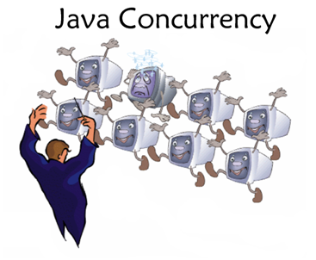
Concurrency
Provide and manage concurrent access to shared resources:
Concurrency control by:
  Fair scheduling
  Preserve dependencies (e.g. distributed transactions)
  Avoid deadlocks
Notes:
Fair scheduling ensures everyone gets a turn on a popular resource
Dependencies occur for transactions. Eg. Buy a book with Credit Card, check that user has sufficient funds before finalising the transaction
Deadlocks can occur when two users hold a resource, and they are waiting for each other to release their respective resource.

Slide 15
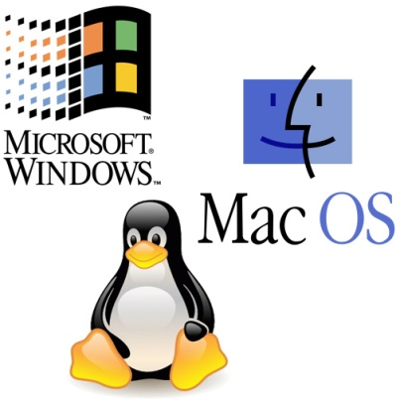
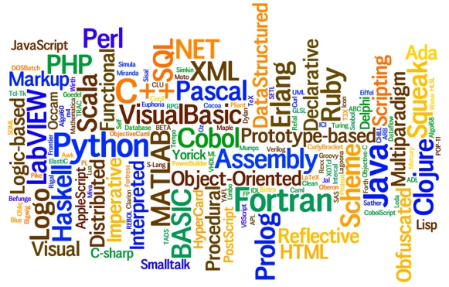
Heterogeneity
Heterogeneous components must be able to interoperate across different:
  Operating systems
  Hardware architectures
  Communication architectures
  Programming languages
  Software interfaces
  Security measures
  Information representation
Notes:
Different OS: Windows, MacOS, Linux, BSD
Hardware: Intel, PowerPC, Sparc, ARM
Comm. Arch’s:
Programming Languages: C/C++, Java, Perl, Python, Ruby, etc
Software interfaces: Common interfaces are needed (RPC, WS)
Security measures: Need to talk same language (3DES, Blowfish, etc)

Slide 16
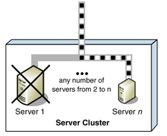
Fault Tolerance
Failure: an offered service no longer complies with its specification
Fault: cause of a failure (e.g. crash of a component)
Fault tolerance: no failure despite faults
Notes:
Failure: service can be no longer available, or be so slow as to be unusable.
Fault: the component that is not functioning correctly.
Fault tolerence: programmed to handle failures if and when they happen, in a graceful way that hides them from users.

Slide 17
Middleware
“a software layer between applications and the OS whose purpose is to mask heterogeneity of the underlying components and to provide a convenient programming model to application programmers.”
Middleware is a class of software technologies designed to help manage the complexity and heterogeneity inherent in distributed systems.
It is defined as a layer of software above the operating system but below the application program that provides a common programming abstraction across a distributed system.

Slide 18
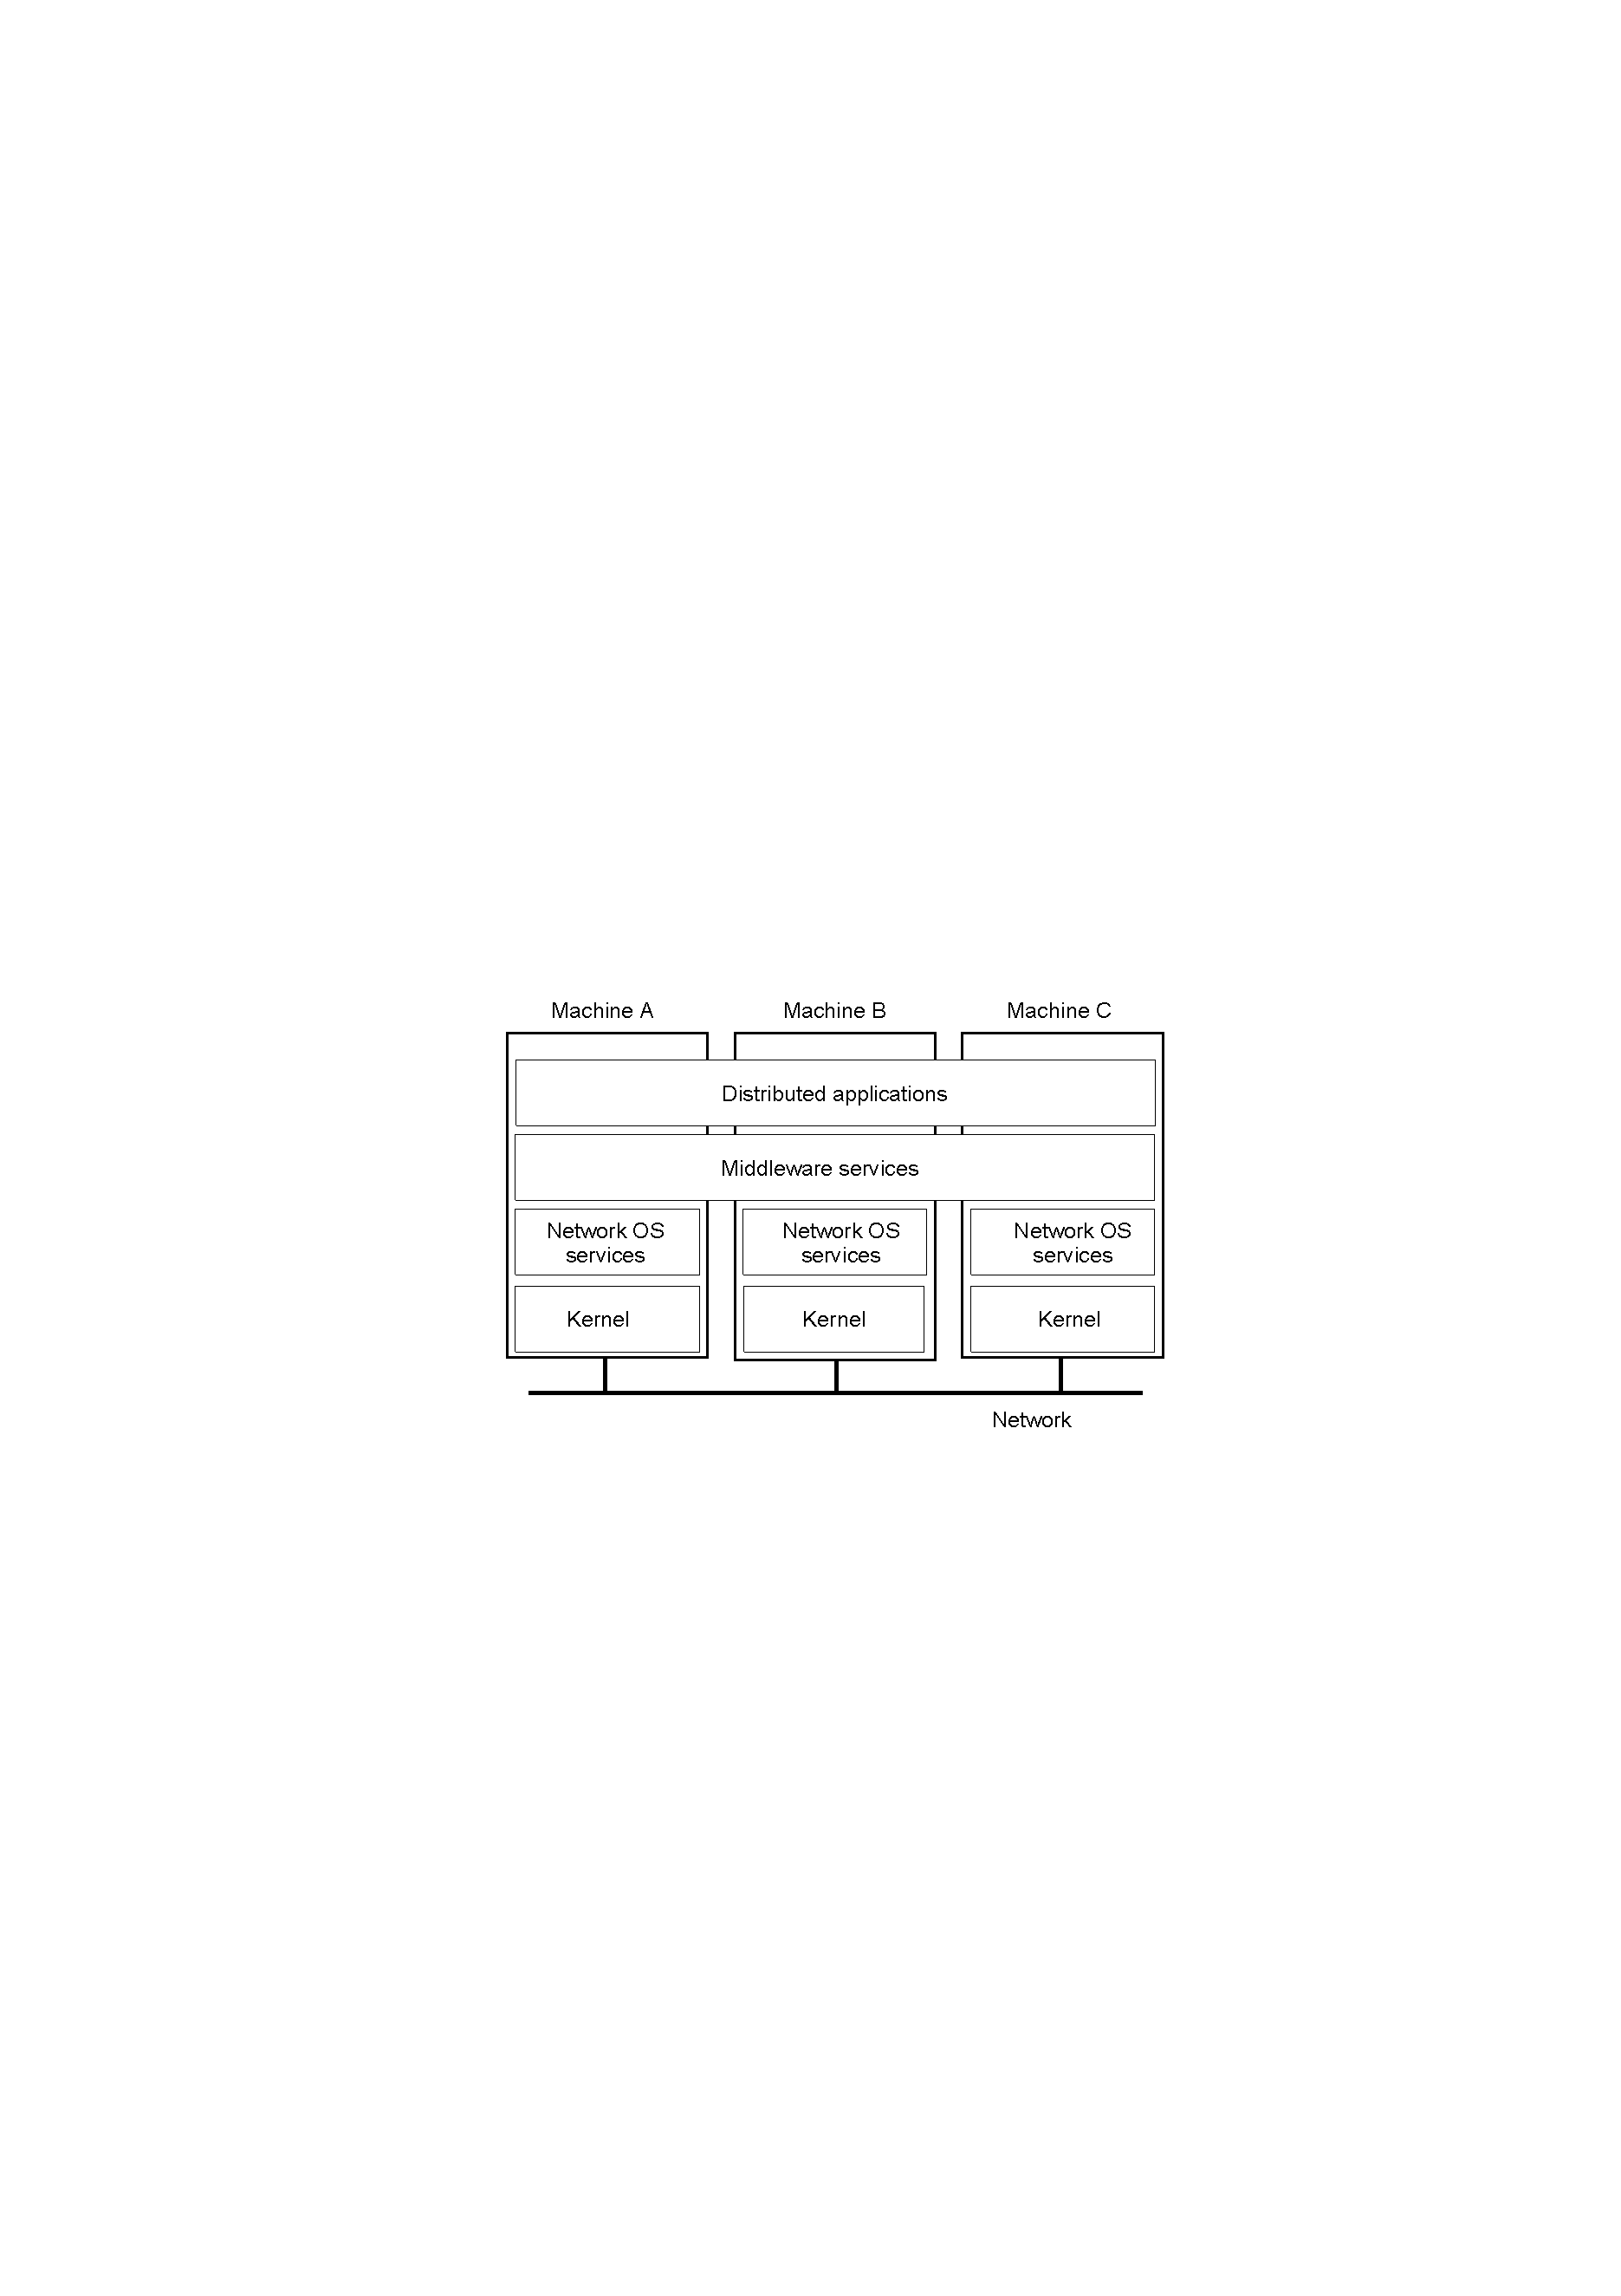
Positioning Middleware
1-22
General structure of a distributed system as middleware.

Slide 19
Middleware
Middleware frameworks are designed to mask some of the kinds of heterogeneity that programmers of distributed systems must deal with.
They always mask heterogeneity of networks and hardware. Most middleware frameworks also mask heterogeneity of operating systems or programming languages, or both.
A few such as CORBA also mask heterogeneity among vendor implementations of the same middleware standard.

Slide 20
Examples of Middleware
Database access technology - e.g ODBC (Open DataBase Connectors)
Java’s database connectivity API : JDBC
Remote computation products - e.g RPC (Remote Procedure Call) and RMI (Java Remote Method Invocation)
Distributed Computing Environment (DCE) products, Common Object Request Broker Architecture (CORBA), Distributed Component Object Model (DCOM)

Slide 21
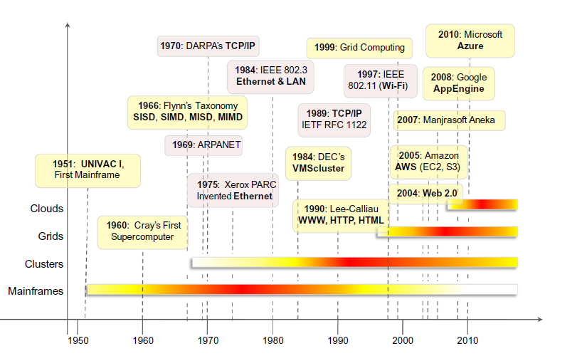


Slide 22
Classification of Distributed Computing
Peer-to-peer Computing
Cluster Computing
Utility Computing
  Grid Computing
  Cloud Computing

Slide 23
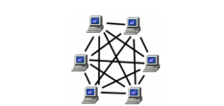
Peer to Peer Computing
In a P2P system, every node acts as both a client and a server, providing part of the system resources.
No central coordination or no central database is needed.

Slide 24
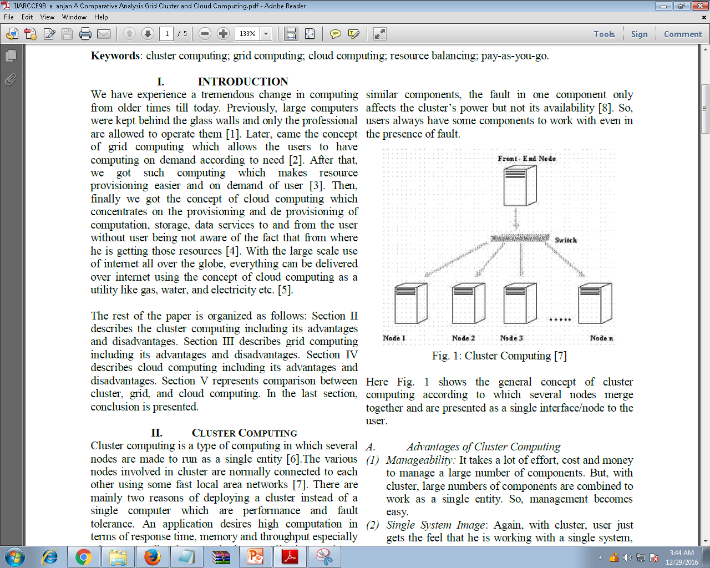
Cluster Computing
Cluster - “A type of parallel or distributed processing system, which consists of a collection of interconnected stand-alone computers cooperatively working together as a single, integrated computing resource” [Buyya].
Notes:
parallel computer has all its compute nodes sharing a single main memory so that processors prefer to communicate locking some memory and writing to it,
whereas distributed multicomputer do not see the common memory and, thus, communicate using a networ, by sending messages to each other

Slide 25
Cluster Computing
The components of a cluster are connected to each other through fast local area networks
Cluster computing provides high computation by employing parallel programming, which is use of many processors simultaneously for a number of or a single problem.
Another reason is fault tolerance which is actually the ability of a system to operate gracefully even in the presence of any fault.

Slide 26
Utility Oriented Computing
Utility computing, is a service provisioning model in which a service provider makes computing resources and infrastructure management available to the customer as needed, and charges them for specific usage rather than a flat rate.

Slide 27
Utility Oriented Computing
utility is used to make an analogy to other services, such as electrical power, that charge for the resources based on usage rather than on a flat-rate basis.
This approach, sometimes known as pay-per-use or metered services, is sometimes used for the consumer market as well, for Internet service, Web site access, file sharing, and other applications
Notes:
The word utility is used to make an analogy to other services, such as electrical power, that seek to meet fluctuating customer needs, and charge for the resources based on usage rather than on a flat-rate basis.
This approach, sometimes known as pay-per-use or metered services is becoming increasingly common in enterprise computing and is sometimes used for the consumer market as well, for Internet service, Web site access, file sharing, and other applications

Slide 28
Grid Computing
Grid - “A type of parallel and distributed system that enables the sharing, selection, and aggregation of geographically distributed autonomous resources dynamically at runtime depending on their availability, capability, performance, cost, and users‘ quality-of-service requirements” [Buyya].
Here individual user gets access to the resources (like processors, storage, data etc.) on demand with little or no knowledge of the fact that where those resources are physically located.

Slide 29
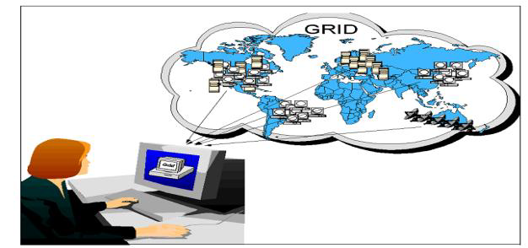
Grid Computing
It employs use of multiple clusters that are loosely coupled, heterogeneous and are geographically dispersed.
Notes:
In computing and systems design a loosely coupled system is one in which each of its components has, or makes use of, little or no knowledge of the definitions of other separate components.

Slide 30
Grid v/s Cluster Computing
Grid Computing | Cluster Computing
Heterogeneous | Homogenous
The computers that are part of a grid can run different hardware as well as have different OS | The cluster computers all have the same hardware and OS
Grid can make use of spare computing power on a desktop computer | The machines in a cluster are dedicated to work as a single unit as well as nothing else
Grid are inherently distributed by its nature over a LAN, MAN or WAN | The computers in the cluster are normally contained in a single location
Every node is autonomous (it has its own resource manager as well as behaves like an independent entity) | Whole system (all nodes) behave like a single system view as well as resources are managed by centralized resource manager

Slide 31
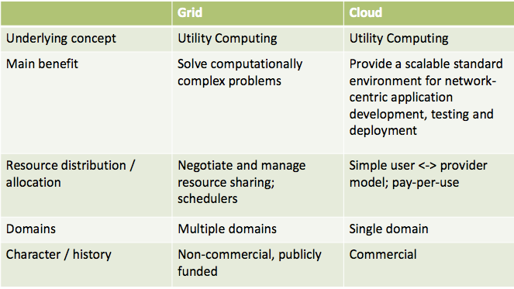
Grid v/s Cloud Computing

Slide 32
Cloud Computing
Cloud – “A type of parallel and distributed system consisting of a collection of interconnected and virtualized computers that are dynamically provisioned and presented as one or more unified computing resources based on service-level agreements” [Buyya].
The main principle behind cloud computing model is to offer computing, storage, and software as a service or as a utility.
We just need internet to use these utilities.

Slide 33
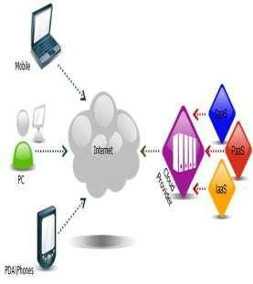
Cloud Computing

Slide 34
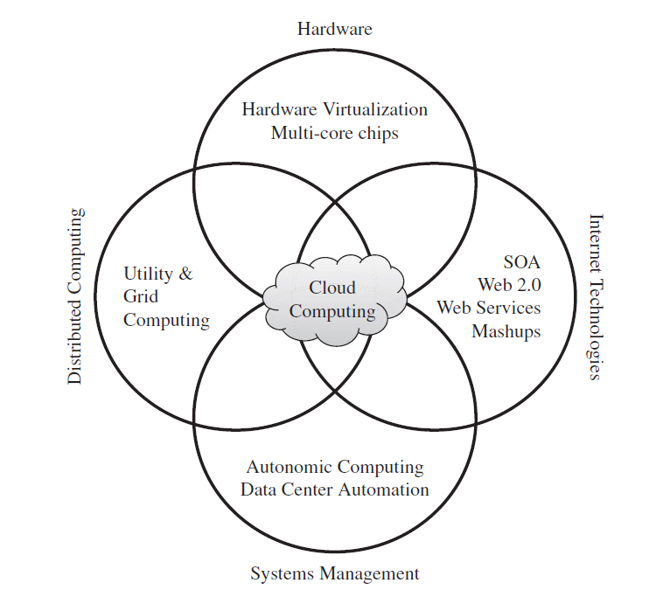
Cloud Computing
Notes:
A mashup (computer industry jargon), in web development, is a web page, or web application, that uses content from more than one source to create a single new service displayed in a single graphical interface.
multi-core is usually the term used to describe two or more CPUs working together on the same chip.

Slide 35
Service-oriented computing
Service orientation is the core reference model for cloud computing systems.
This approach adopts the concept of services as the main building blocks of application and system development.
Service-oriented computing(SOC) supports the development of rapid, low-cost, flexible, interopera- ble, and evolvable applications and systems.

Slide 36
Service-oriented computing
Service-Oriented Computing (SOC) is the computing paradigm that utilizes services as fundamental elements for developing applications/solutions.
Services are self- describing, platform-agnostic computational elements that support rapid, low-cost composition of distributed applications.
Services perform functions, which can be anything from simple requests to complicated business processes.

